Slide 1



Quiz
Application
Guided by :
Made by :
Ms. Sameeksha
Khandelwal
Durgesh Mishra,
Harsh Verma,
Bhumika Kanojia

Slide 2

ABSTRACT
“Quiz application ” is a collection of different quizzes likes technical, General knowledge, English Grammar, Quantitative Aptitude.
User can access only one quiz at a time.
There will be a limited number of questions and for each correct answer user will be get a credit score.
To develop a user friendly application, our application will contain :
Number of quiz.
Answer to every question.
Feedback.

Slide 3
INTRODUCTION
This quiz website provide a great platform for practice and solving query by taking feedback from the user, which is having a great user interface.
The proposed work in this field are available on internet in huge amount like ; many website are available for playing quizzes online and query solving of the users.
These website provide a large varieties of questions (Big Domain).
These website provides question and answer for quiz ,query box for query solving .
Also, these website provide hug amount of study material for the users.

Slide 4
PROBLEM DOMAIN
“Our aim is to develop a application for the users in which a user can attempt any number of quiz related to his/her choice”
Firstly, we have to make interface for Home Page, Registration , Login Page, Question Attempting Forum, Result Page and profile of user and as well as for Admin. These all pages have connectivity with the server and database.
Currently, there are websites which only provide limited number of quizzes related to different domain.
Many website do not have a single platform for quizzes related to Technical, G.K , Aptitude, Grammar, etc. And there is not a website where the users can upload his/her question and answer for others.
We have to develop a application which can resolve all the problems.

Slide 5
SOLUTION DOMAIN
In this application firstly the user need to register or login using user-id and password.
Then the user can choose any of the quiz of his/her choice.
There is a instruction window.
User can start attaining the quiz.
User can see his/her answers are right or wrong and can also see the answer of each.
If there is any feedback he/she can send.
After completion of the quiz user will get credit score for each of its correct answers.
Admin will submit question, after submission of 10 question in each category the quiz list will increase dynamically.
The user profile will contain it name, age, qualification, gender, mobile number, credit score, etc.

Slide 6
SYSTEM DOMAIN
In the project “Quiz Application” we are using the HTML 5 for designing the respective web pages and CSS is applied to these web pages for its better UI.
HTML is been used for development of static pages. For dynamic web pages we are using JSP and SERVLET.
For coding purpose we are using JAVA language in our project.
For the communication between the HTML and JAVA we are using the JAVA SCRIPT .Also for the session management in the web page JAVA SCRIPT is used.
For the backend purpose we are using MYSQL as database . In our database the question and result of the user will be stored.
For the communication between JAVA and MYSQL we are doing java database connectivity using JDBC driver.
The project runs on the GLASSFISH server.

Slide 7
APPLICATION DOMAIN
The project “Quiz Application” can be used for educational purpose by many school and also by coaching institute.
It can also be used by a person for his/her self improvement and knowledge test.
A user can gain knowledge by playing this quiz not only technically but also in various fields like G.K, TECHNICAL and APTITUDE.
This project can also be used by a group for their knowledge sharing among themselves by playing quiz individually.

Slide 8
EXPECTED OUTCOME
User can attempt any type of quiz from the given list.
Result of the quiz attempted by the user will be displayed.
User can know his/her level of knowledge in the current world.

Slide 9
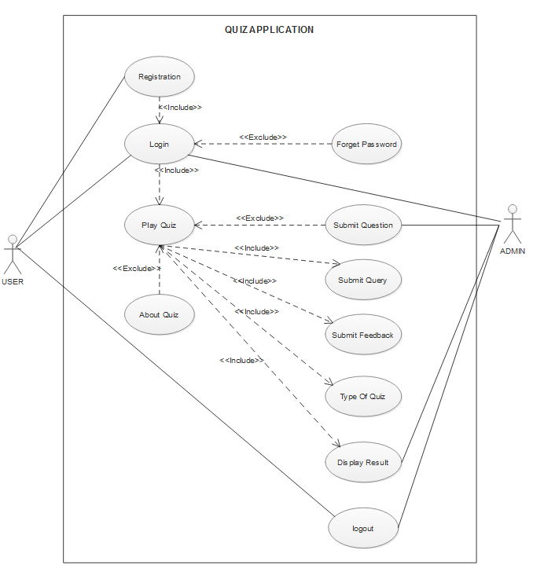
Use Case Diagram :

Slide 10
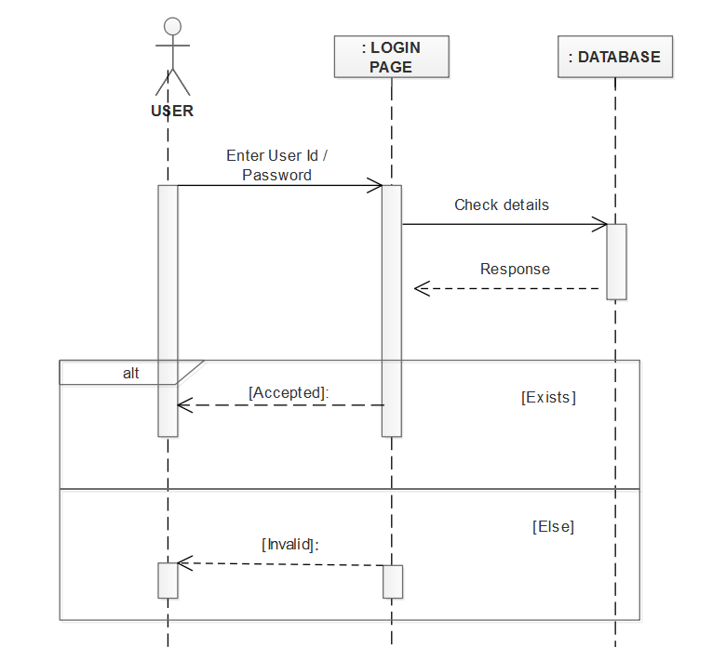
Sequence Diagrams for Login:

Slide 11
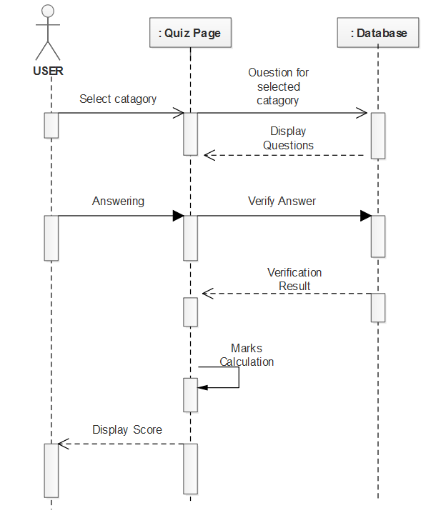
Sequence Diagrams for Play Quiz: sdh

Slide 12
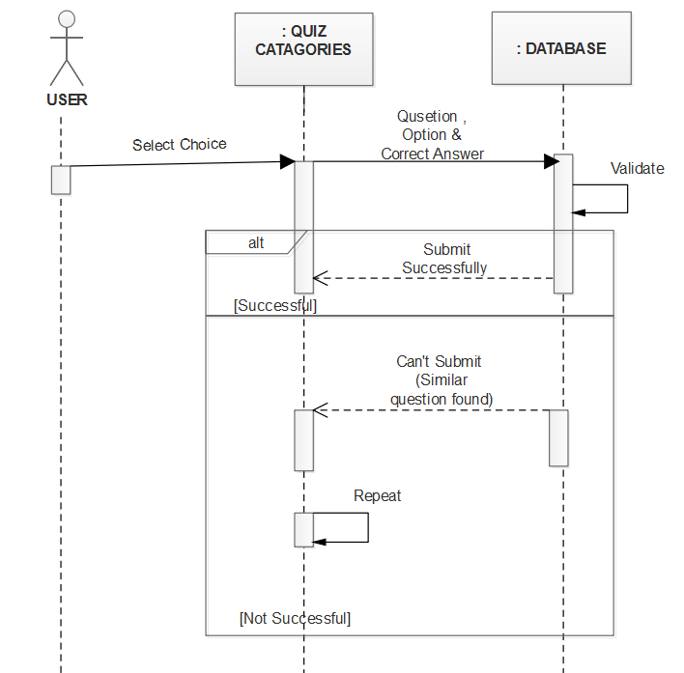
Sequence Diagrams for Submit Question:

Slide 13
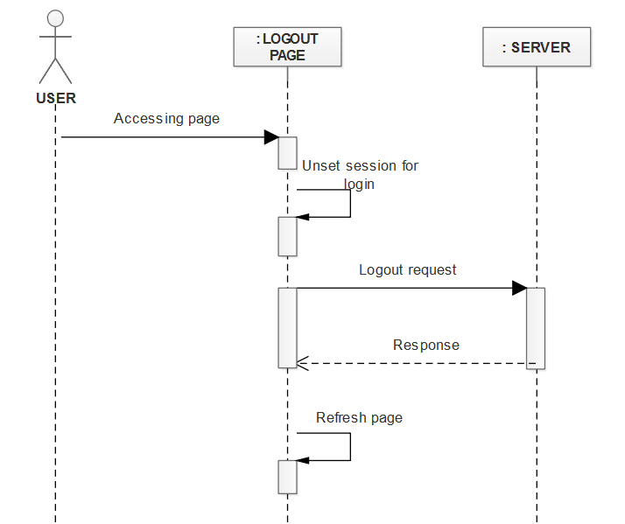
Sequence Diagrams for Logout:

Slide 14
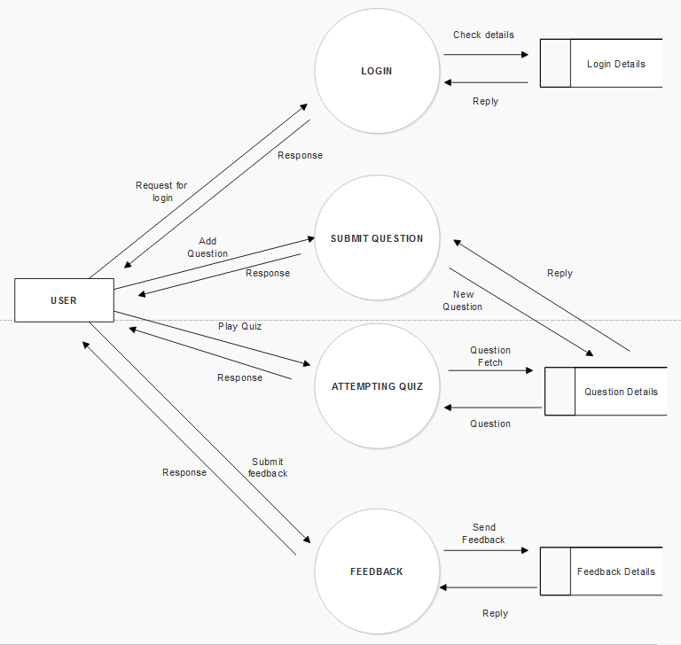
Data Flow Diagram:

Slide 15
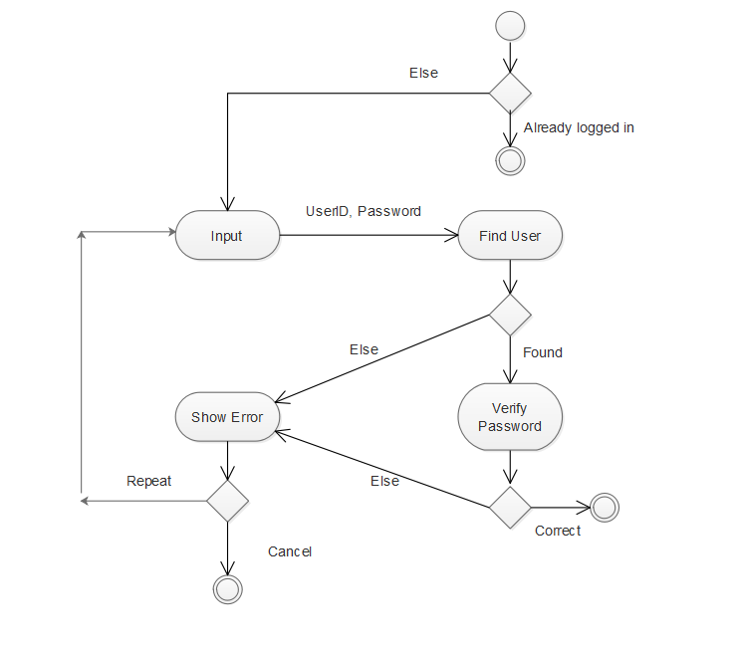
Activity Diagram for Login:

Slide 16
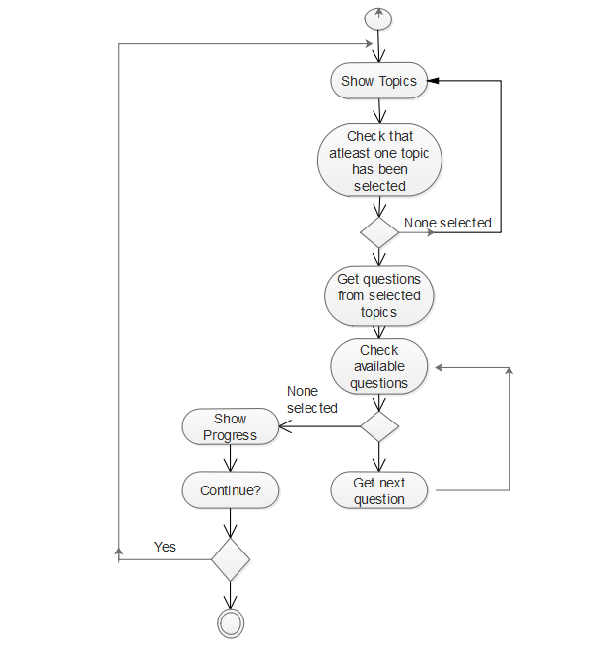
Activity Diagram for Play Quiz:

Slide 17
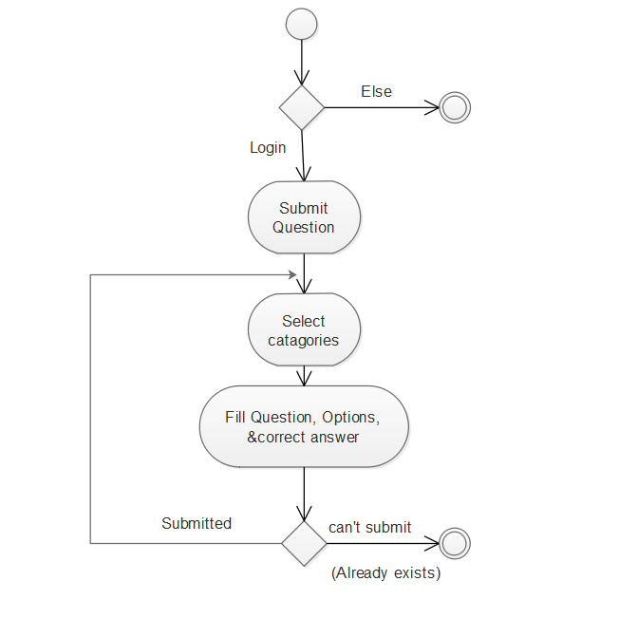
Activity Diagram for Submit Question:

Slide 18
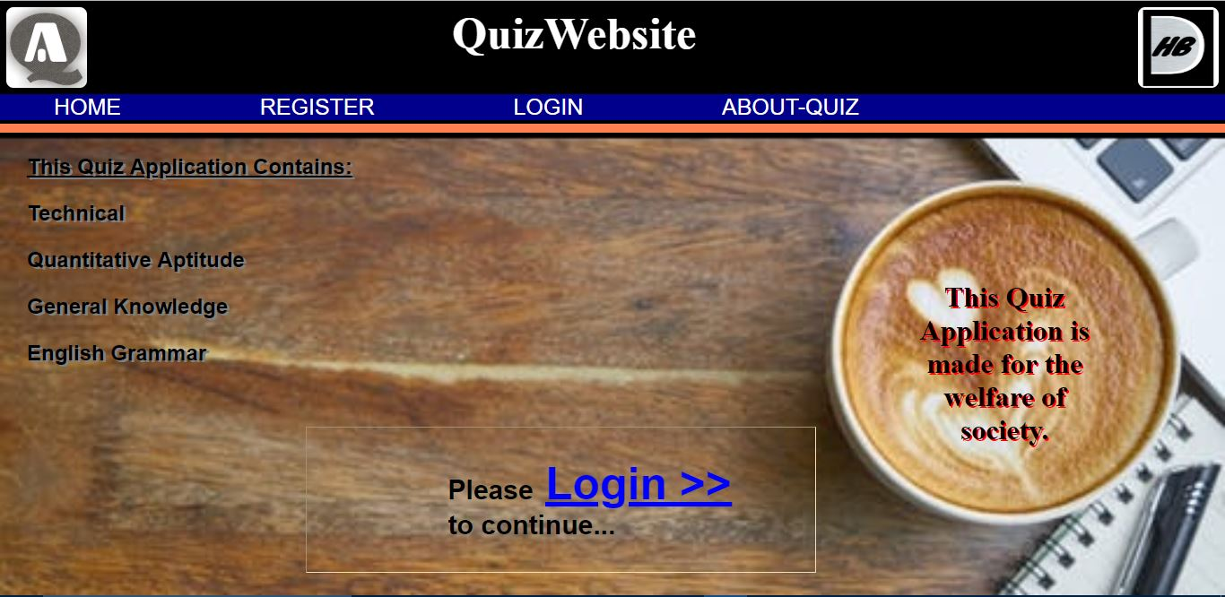
Screen Shots : Home Page

Slide 19
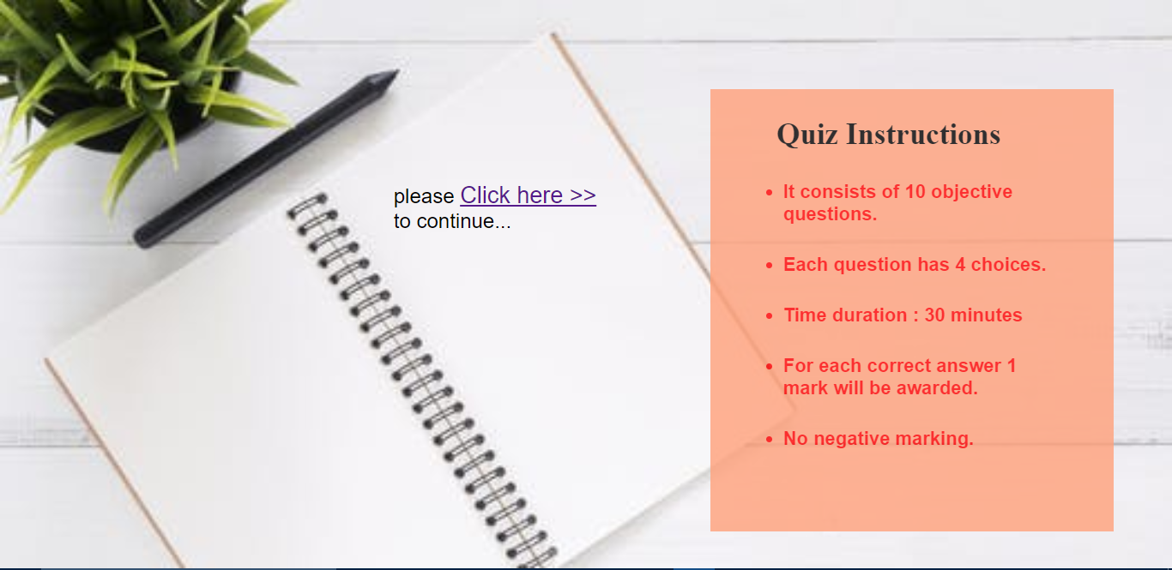
About Quiz:

Slide 20
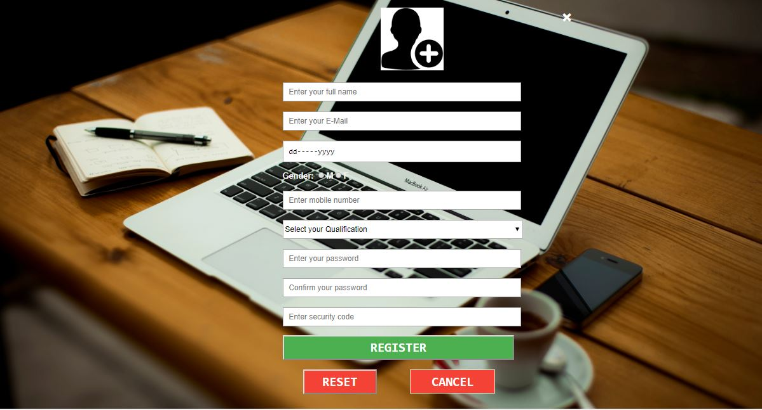
Registration pAge:

Slide 21
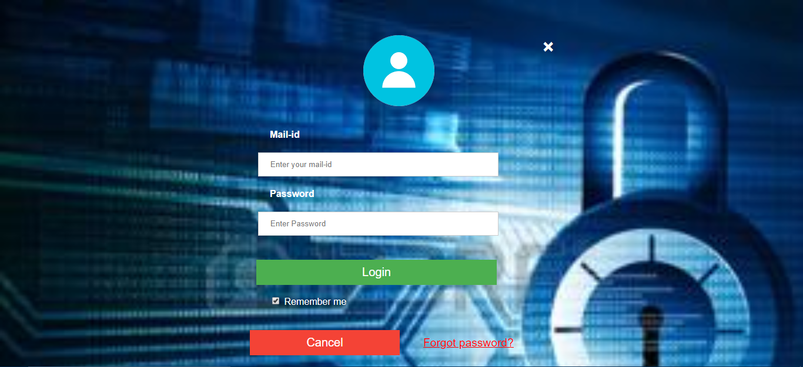
Login page:

Slide 22
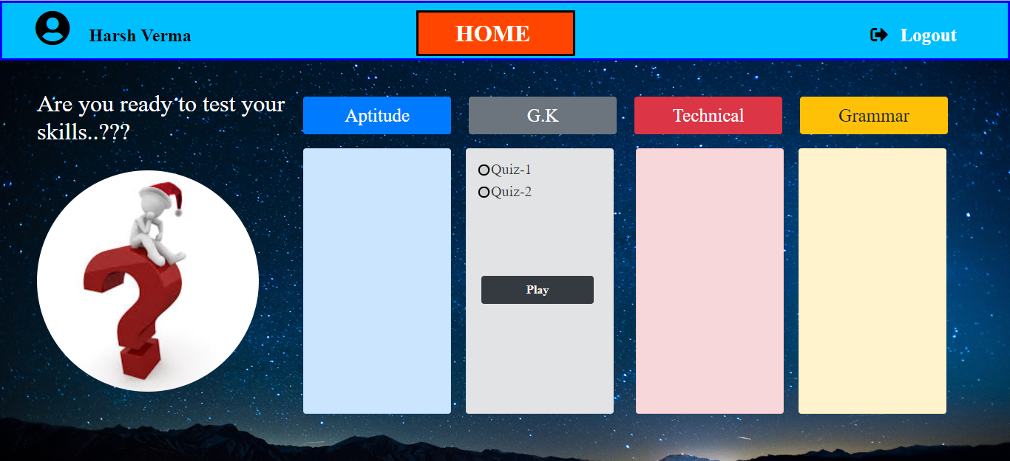
User home page:

Slide 23
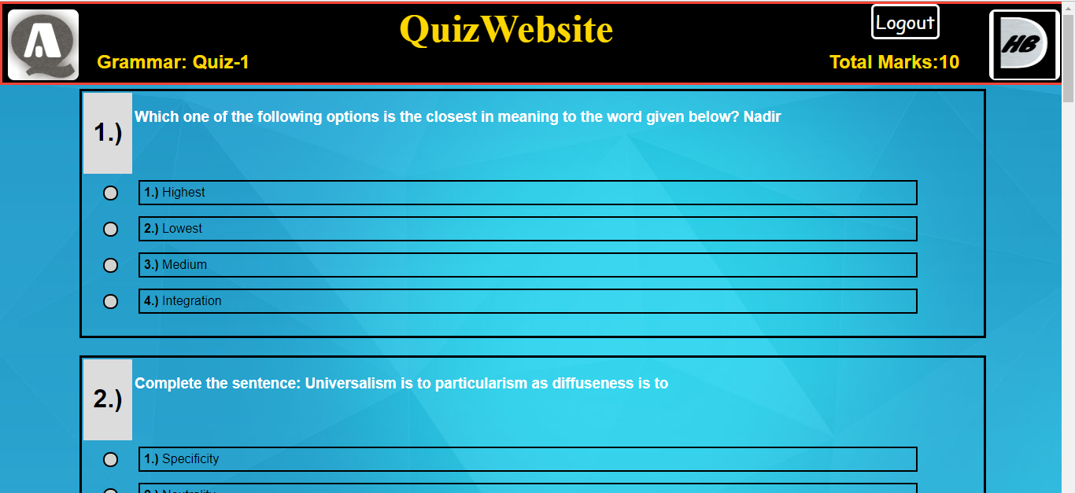
Attempting Quiz:

Slide 24
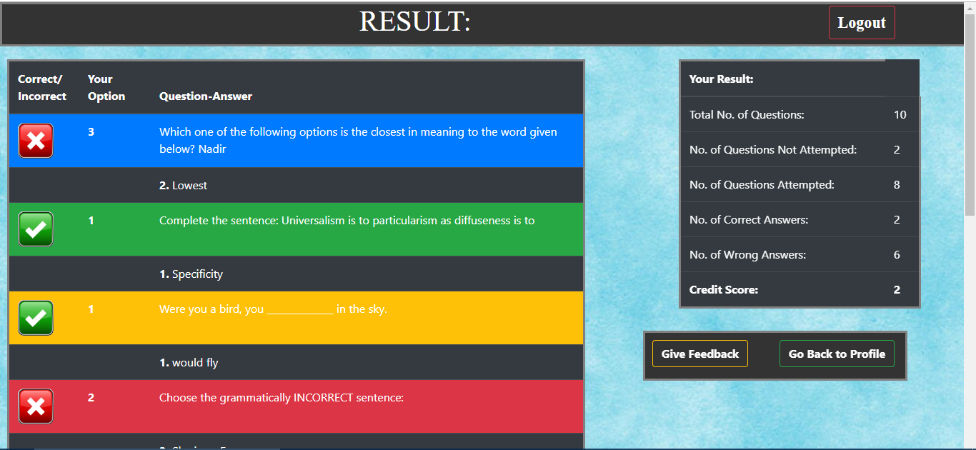
Result page:

Slide 25
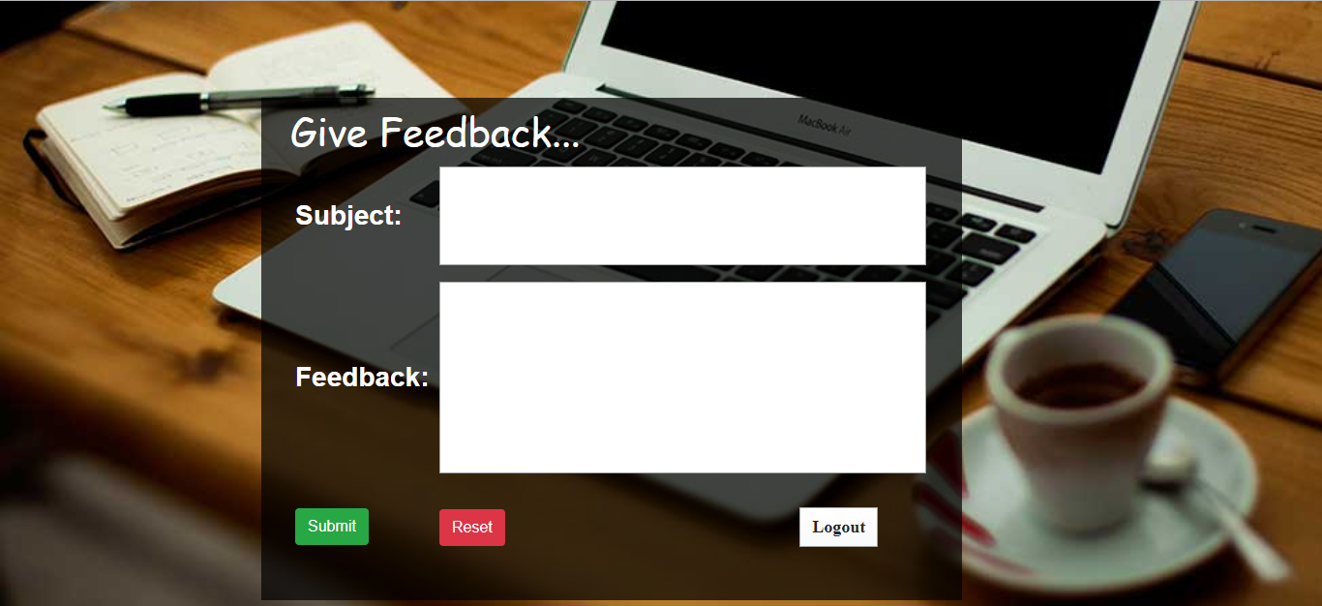
Feedback Page :

Slide 26
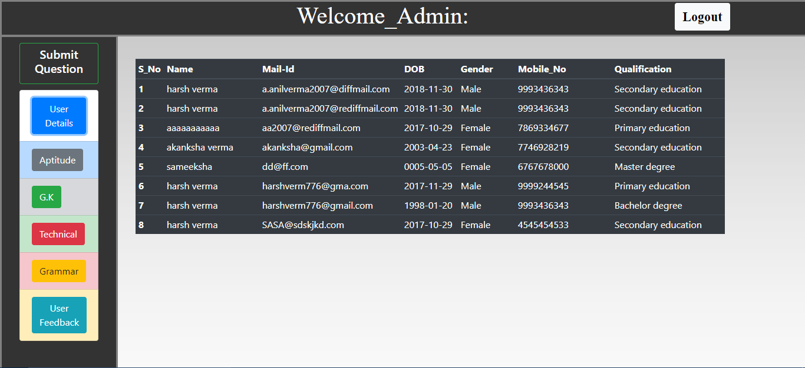
Admin Page :

Slide 27
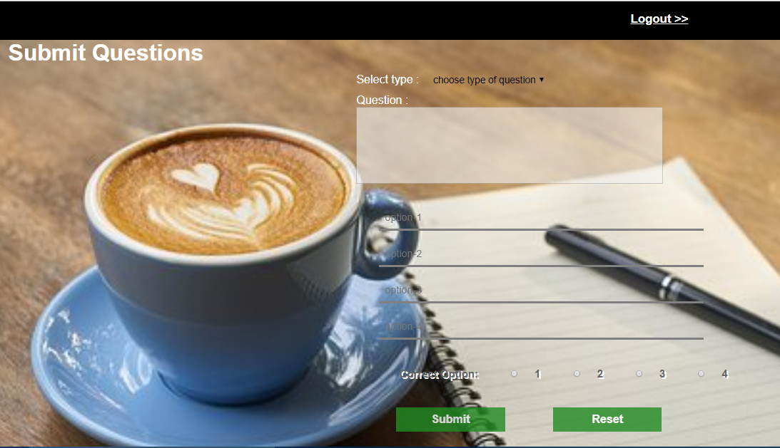
Submit question :

Slide 28
Thank You…

